Slide 1

STUDY ON HASH FUNCTION
SECTION 2 PRESENTATION
TEAM NAME: INNOVATORS

Slide 2
STATEMENT
In the second section various functions of hash functions were to be studied and to secure the data from ethical hackers

Slide 3
OBJECTIVE
The main objective of this is to study is to know about various hash functions.
To execute the code and learn the language sucessfully

Slide 4
FLOW DIAGRAM
INSTALLATION OF THE SOFTWARE
SOFTWARE SETUP
STUDY ON LANGUAGE
PROGRAMMING AND EXCECUTION

Slide 5
INSTALLATION
The software used is Ubuntu
In that from Zokrates repository the files were retrieved and executed for database setup
After setup the codes for specific tasks were executed.
The detailed explanation and the execution of codes were explained in the upcoming slides.

Slide 6
GITHUB ZOKRATES REPOSITORY PROGRAAMING LEARNING

Slide 7
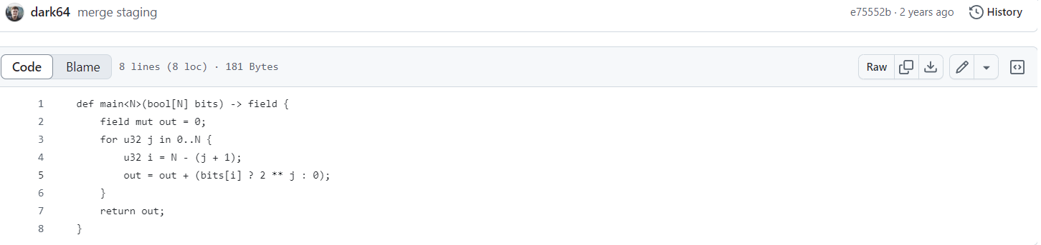


Slide 8
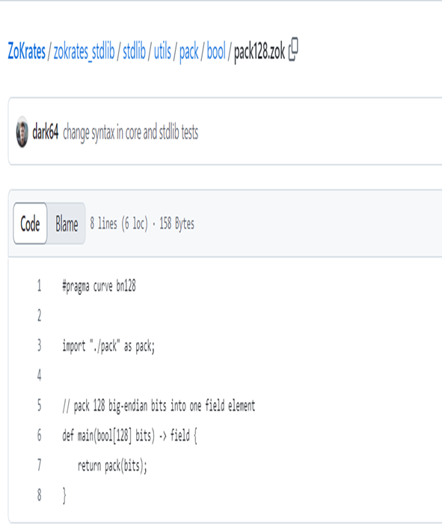

Slide 9
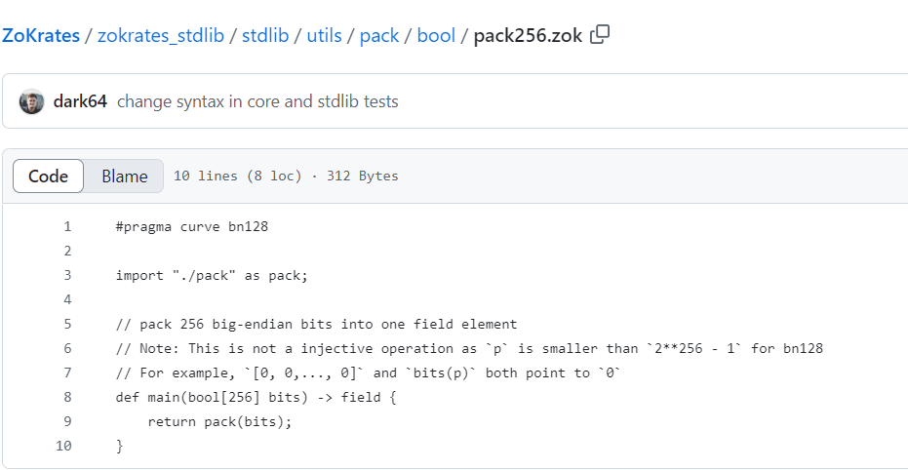

Slide 10
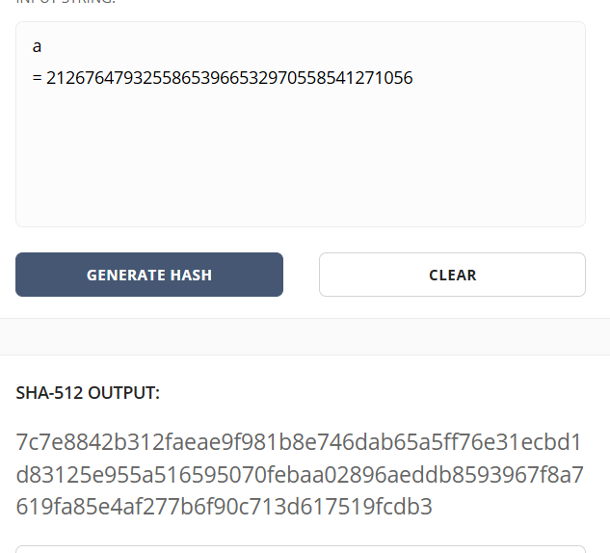
HASH EXECUTION

Slide 11
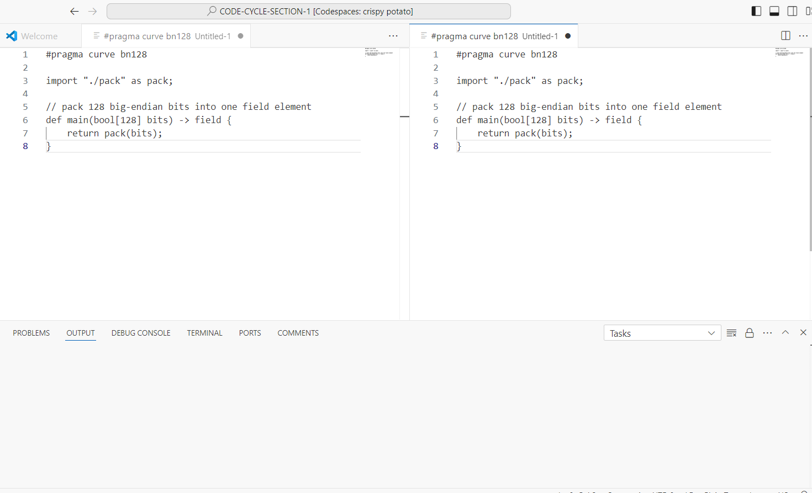
ORIGINAL FLE SIZE : 128 bit

Slide 12
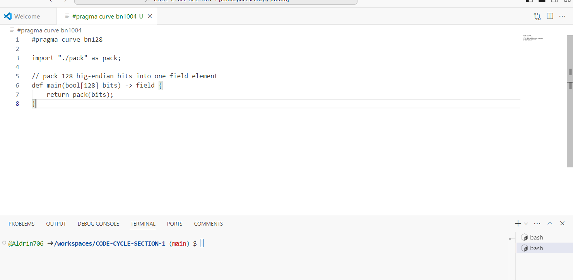
FILE SIZE CHANGE : 1004 bit

Slide 13

CONCLUSION
Therefore the language was able to learn as much as possible
The various features were explored
The coding is executed
The file size was changed
Overall a clear overview about the programming language was able to learn in a fruitful manner.

Slide 14
THANK YOU

